Slide 1


Slide 2
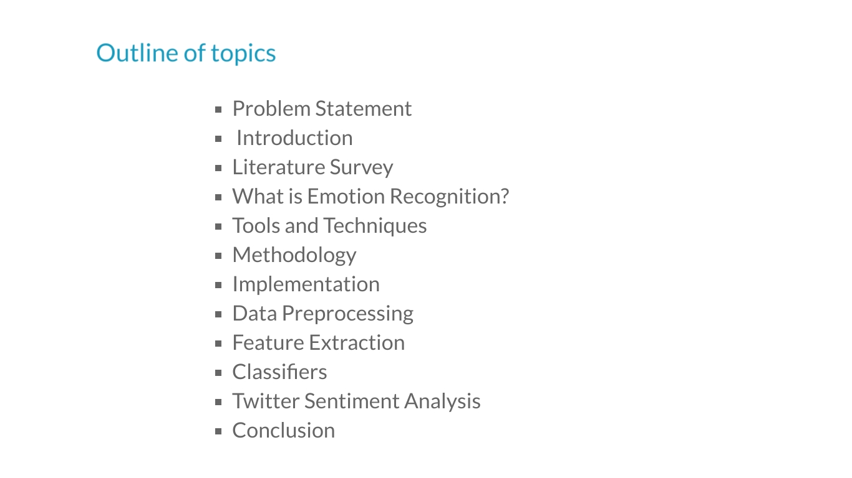

Slide 3
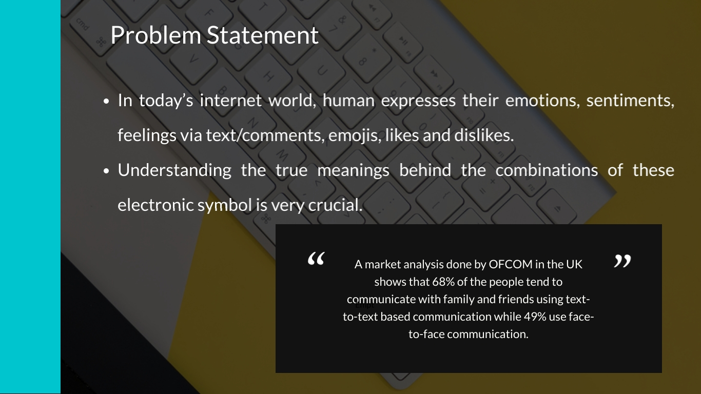

Slide 4
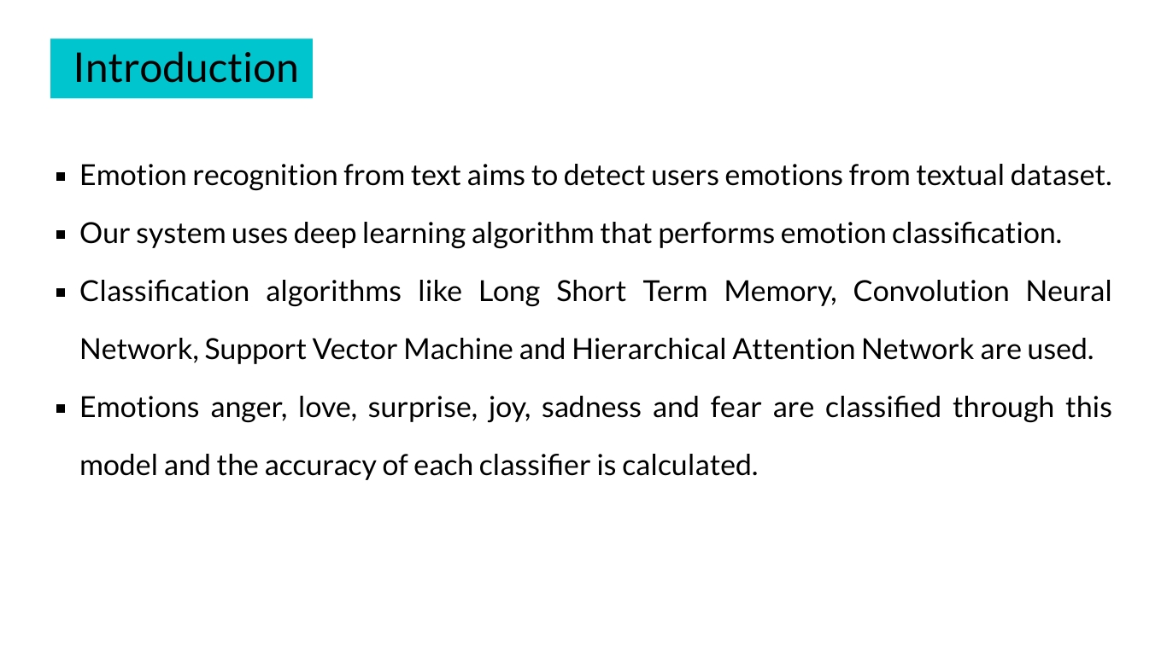

Slide 5
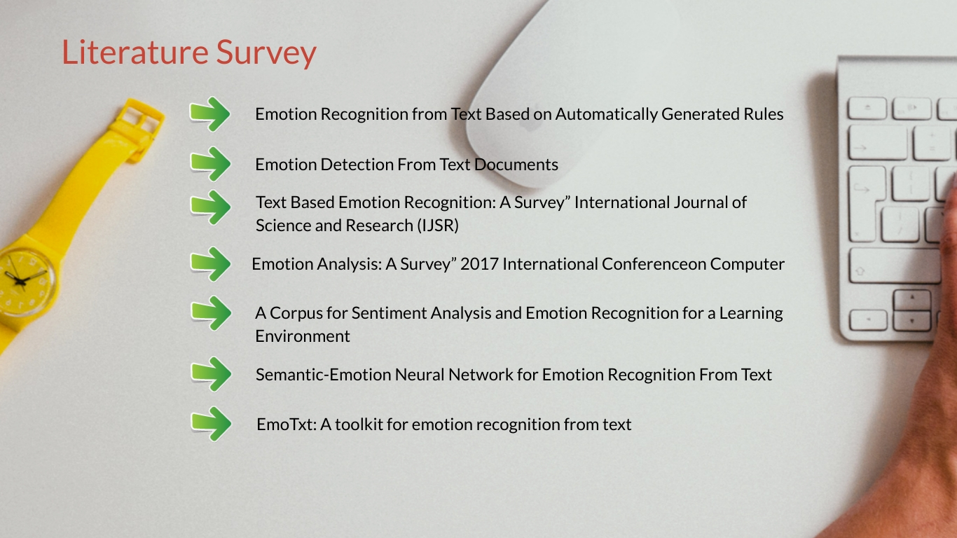

Slide 6
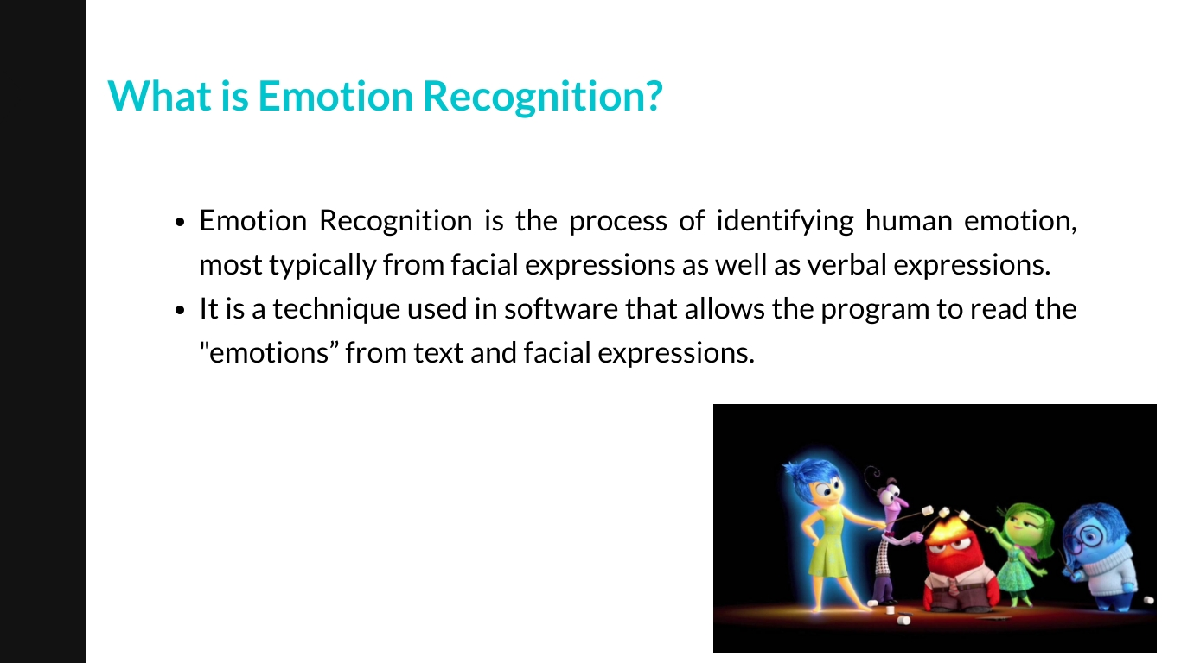

Slide 7
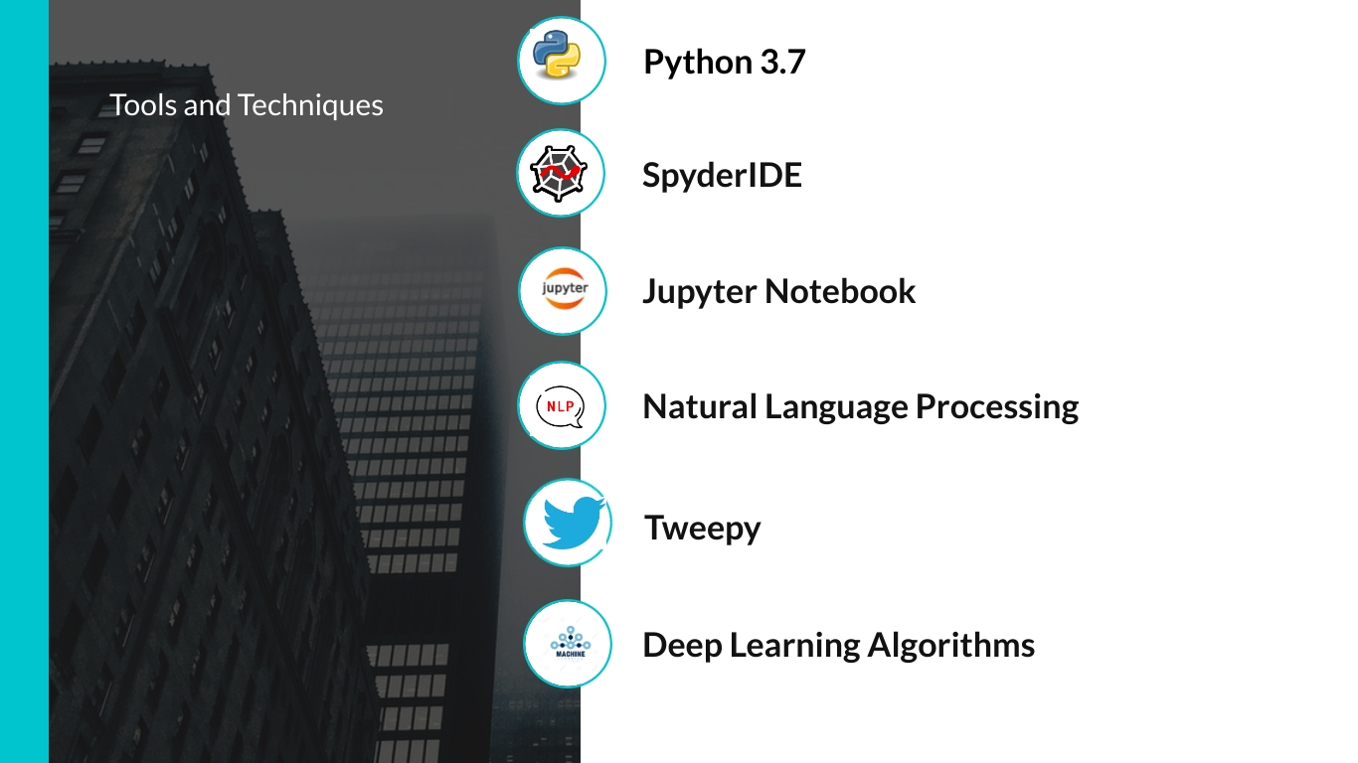

Slide 8
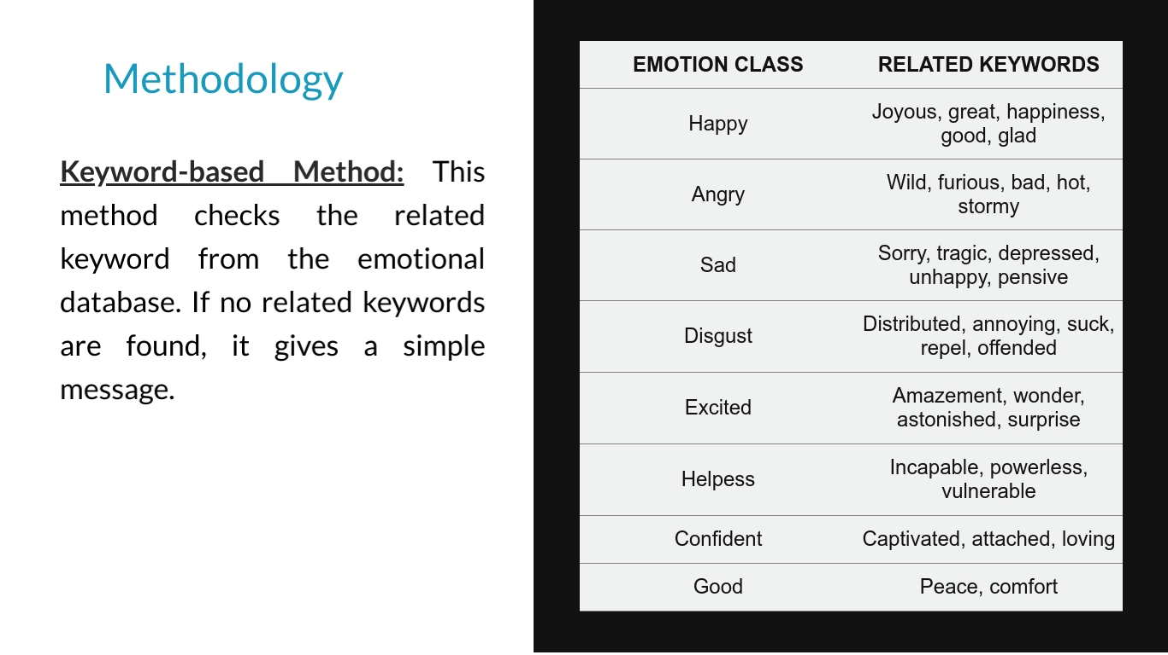

Slide 9


Slide 10


Slide 11
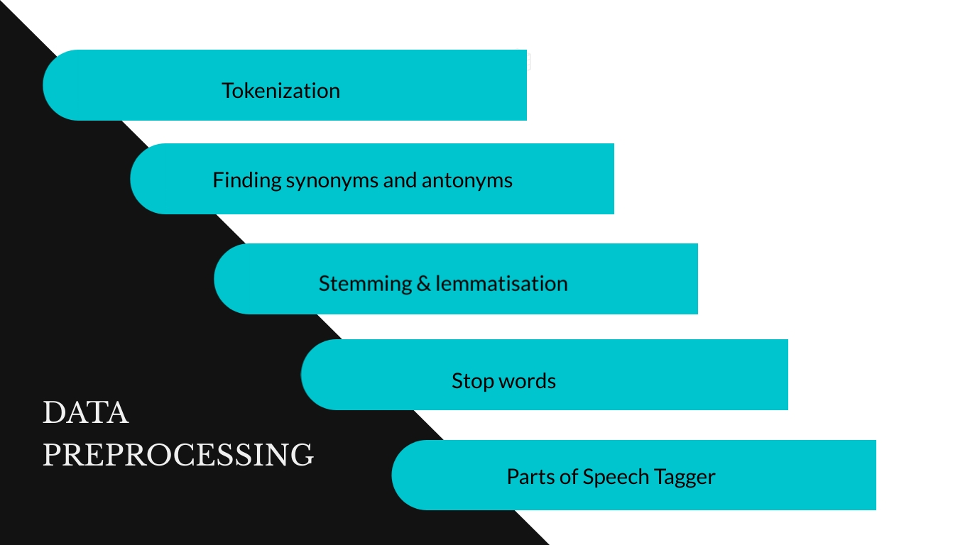

Slide 12
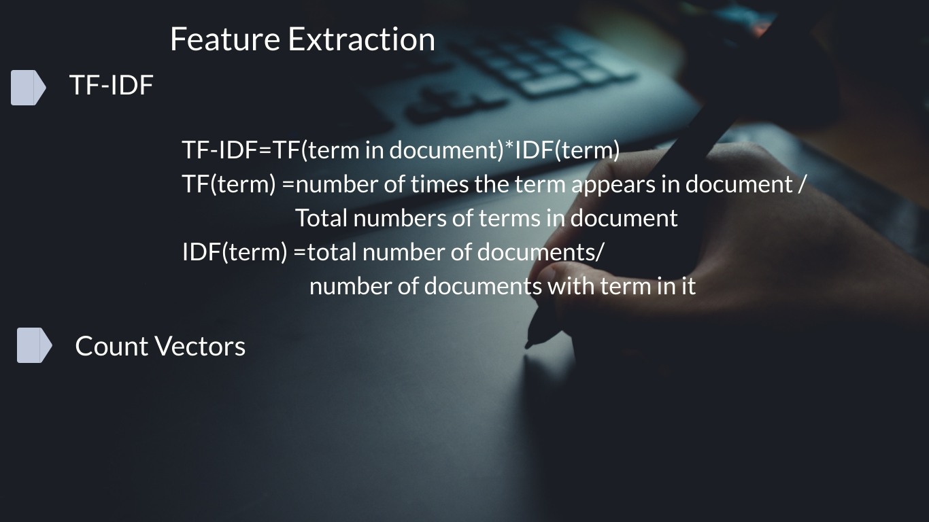

Slide 13


Slide 14
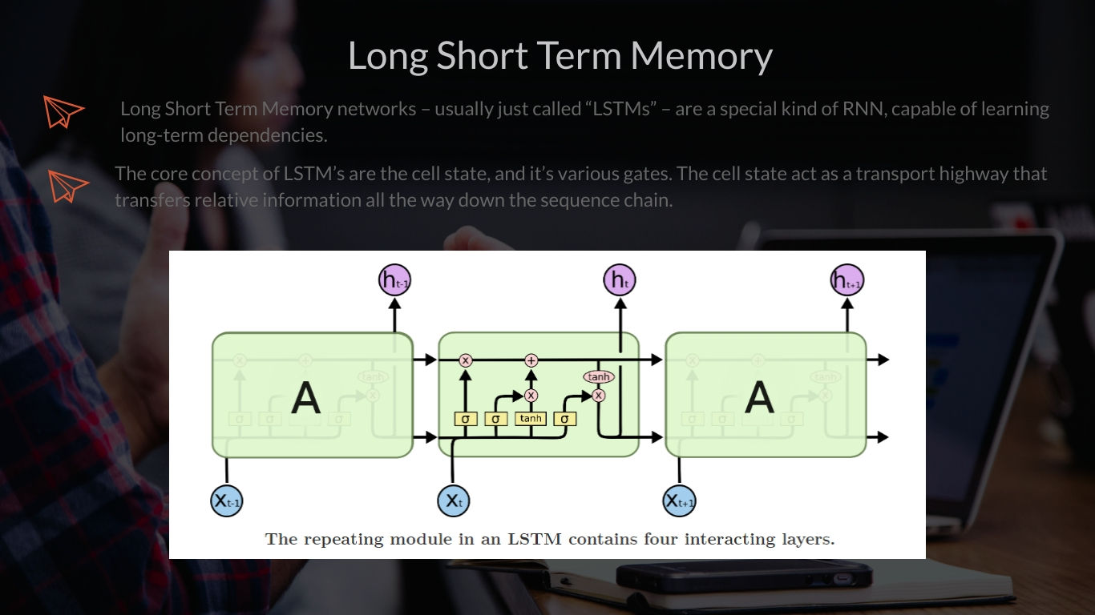
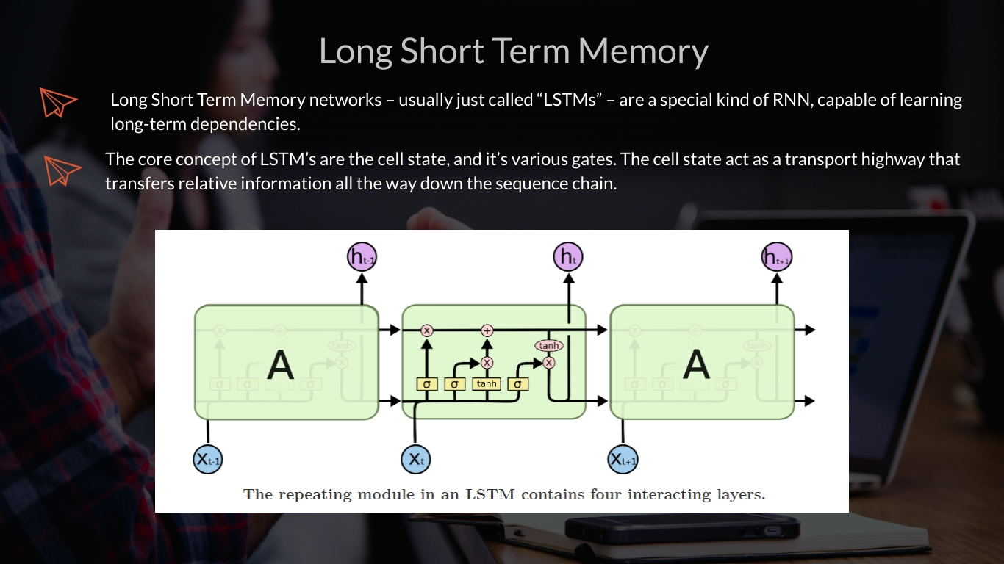

Slide 15
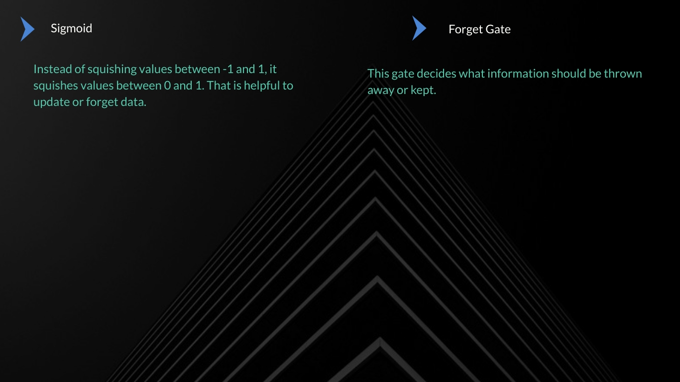
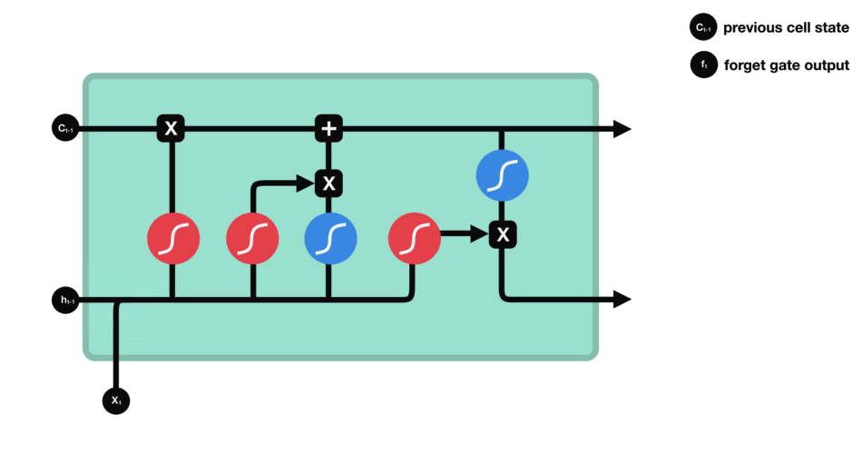
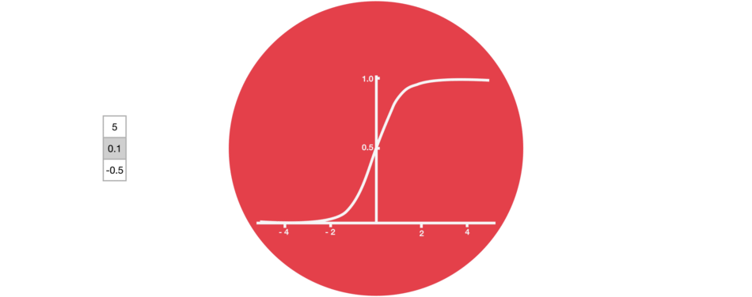

Slide 16
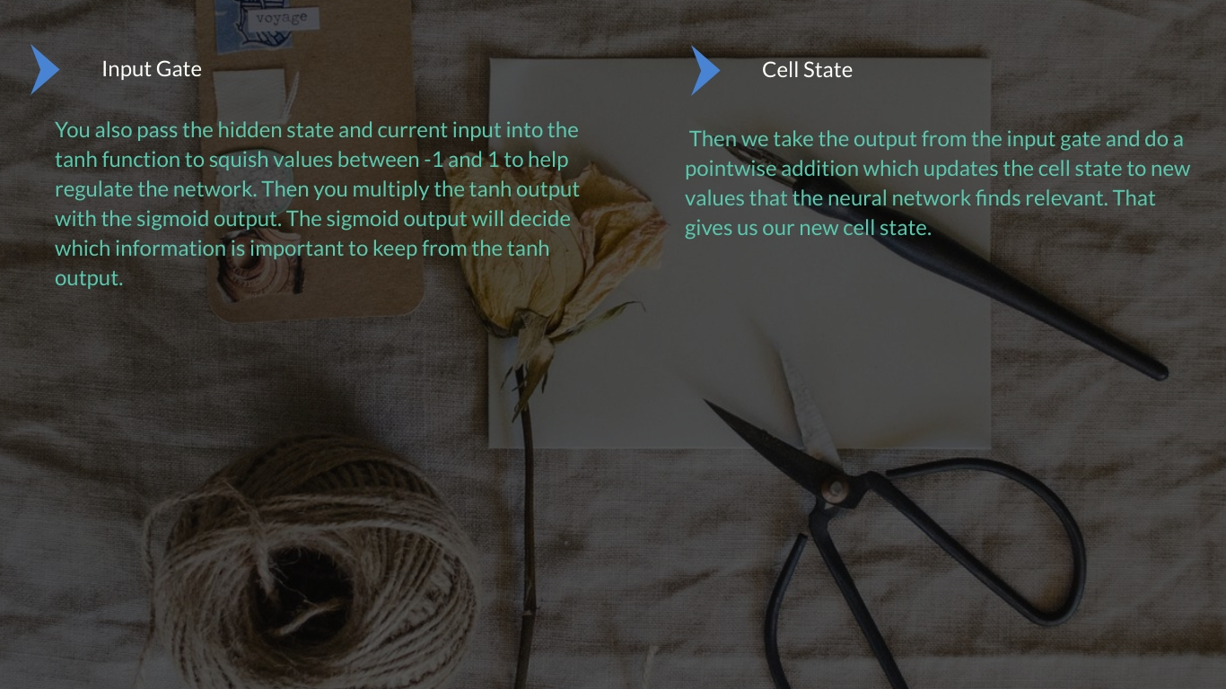
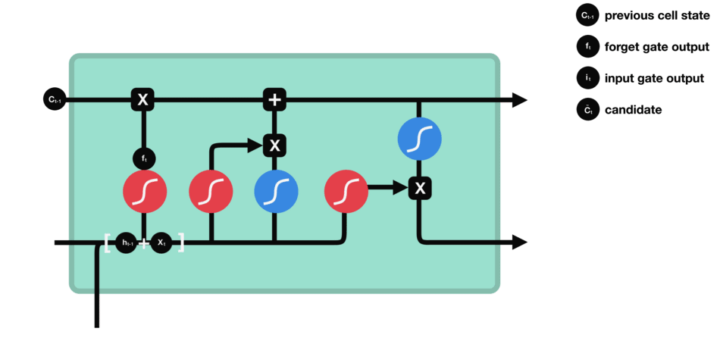
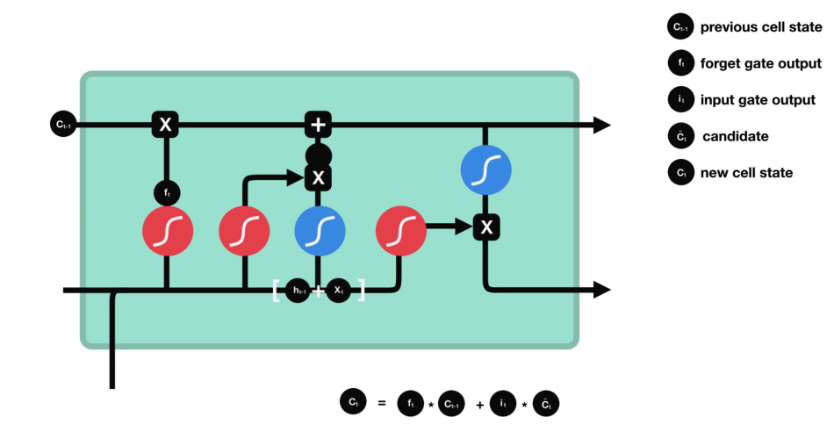

Slide 17



Slide 18
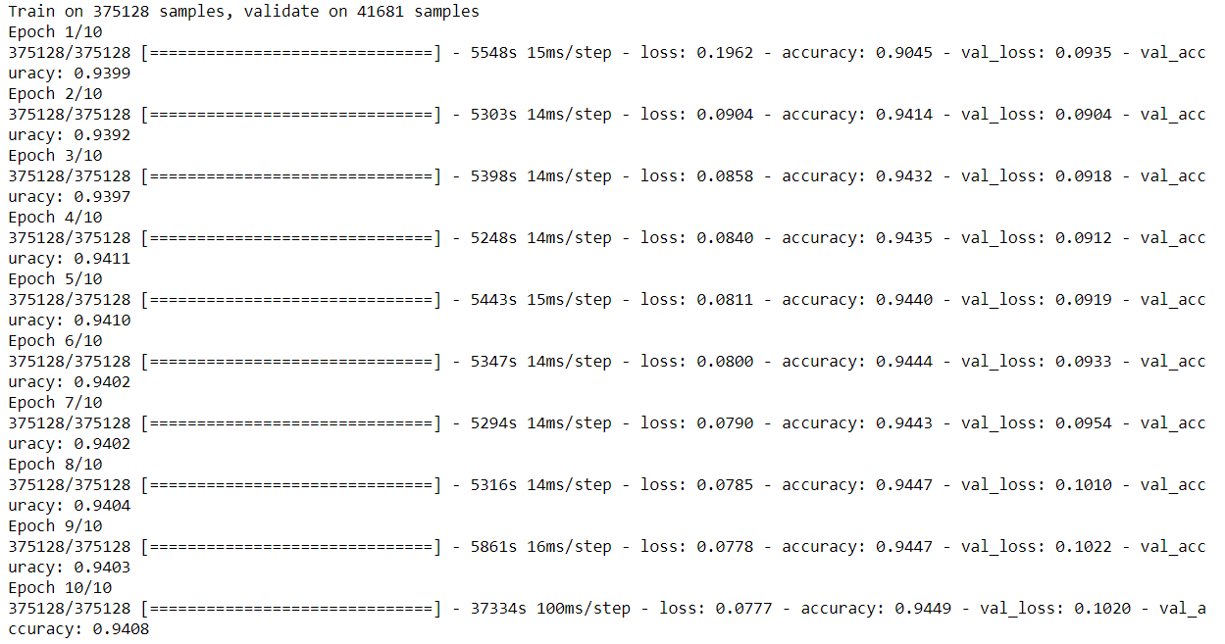
LSTM Epochs

Slide 19
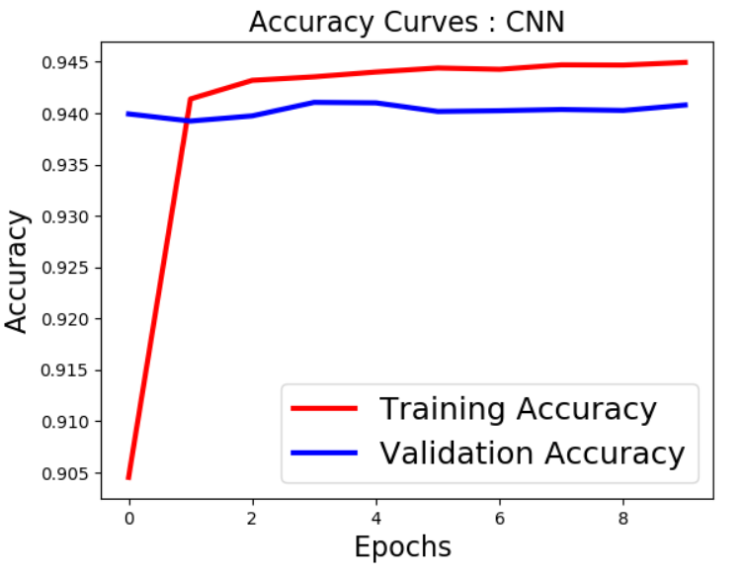
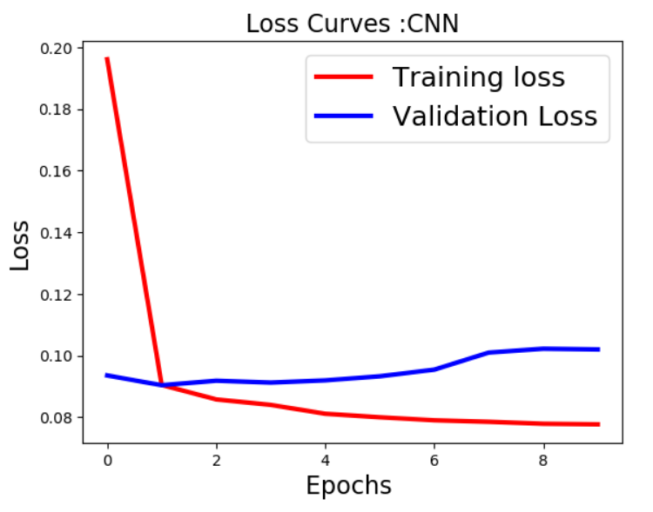
Graphs
Accuracy Curve: LSTM
Loss Curve: LSTM

Slide 20
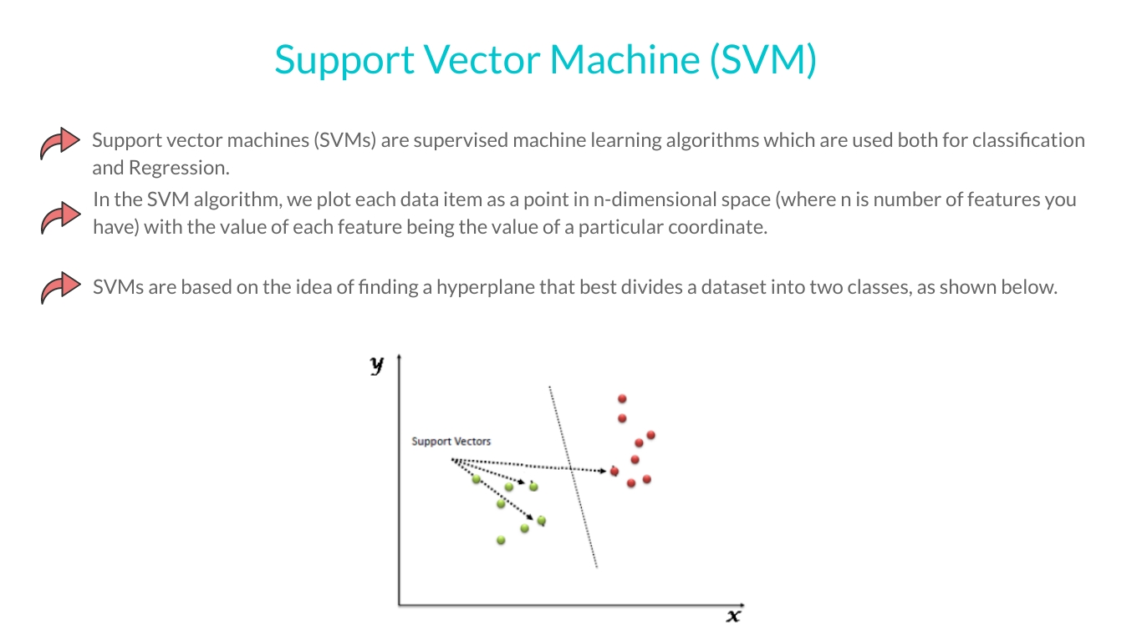

Slide 21
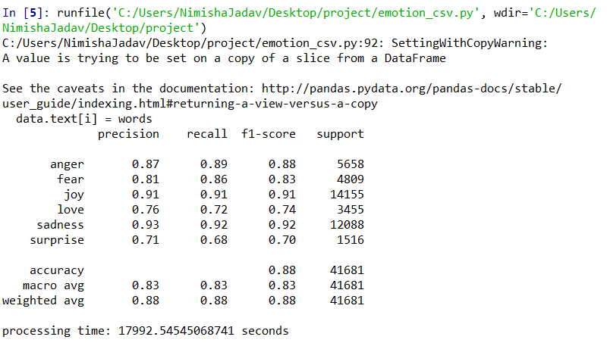
SVM Output

Slide 22
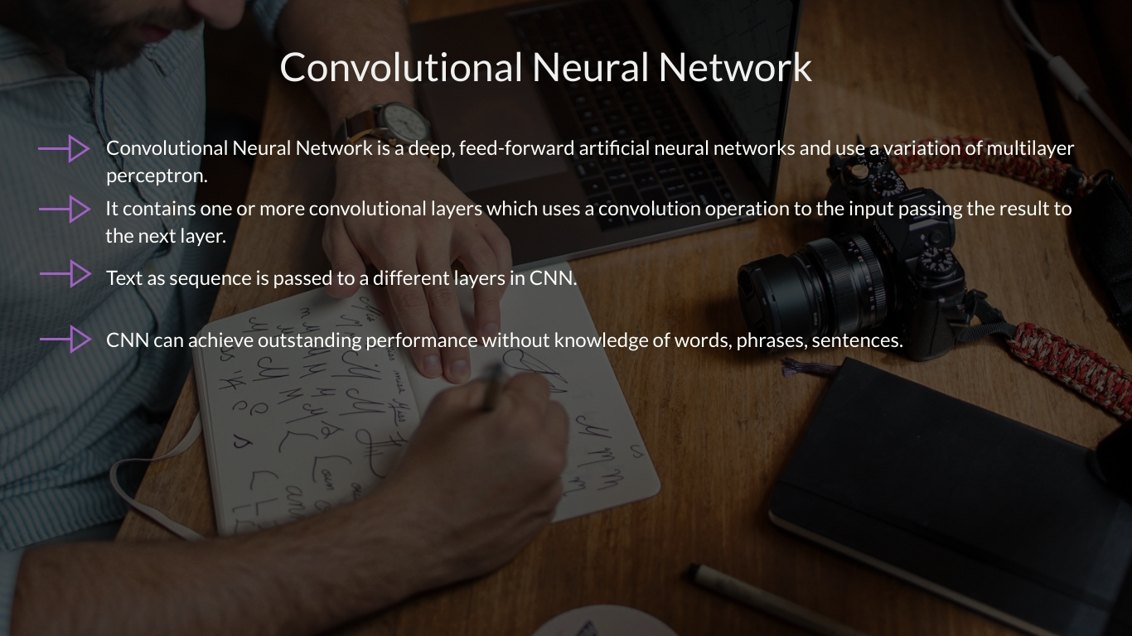

Slide 23

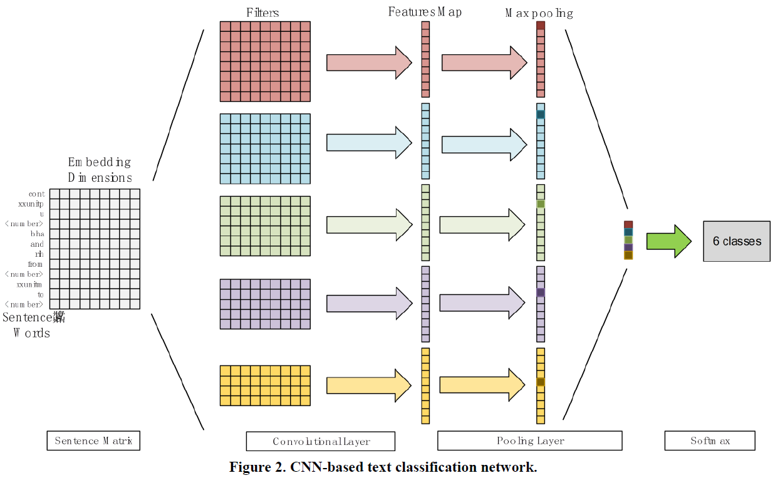

Slide 24
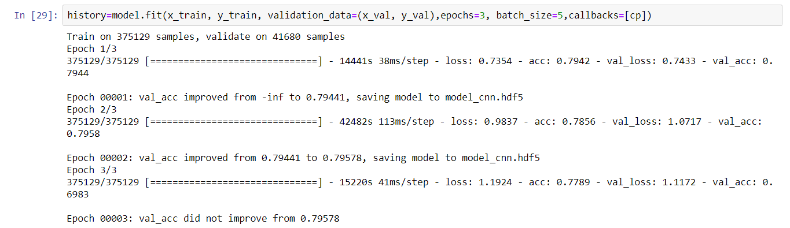
CNN Epochs

Slide 25
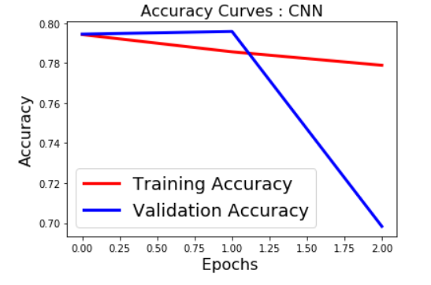
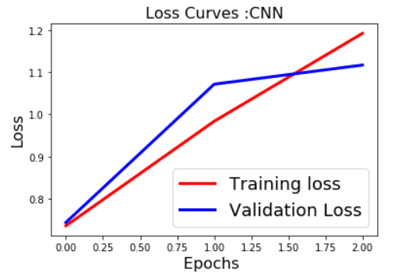
Graphs

Slide 26
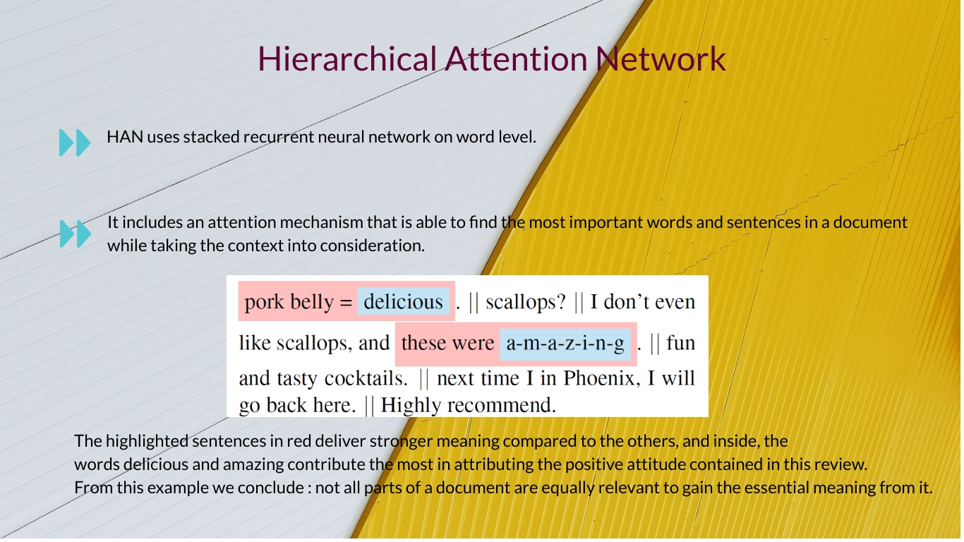

Slide 27
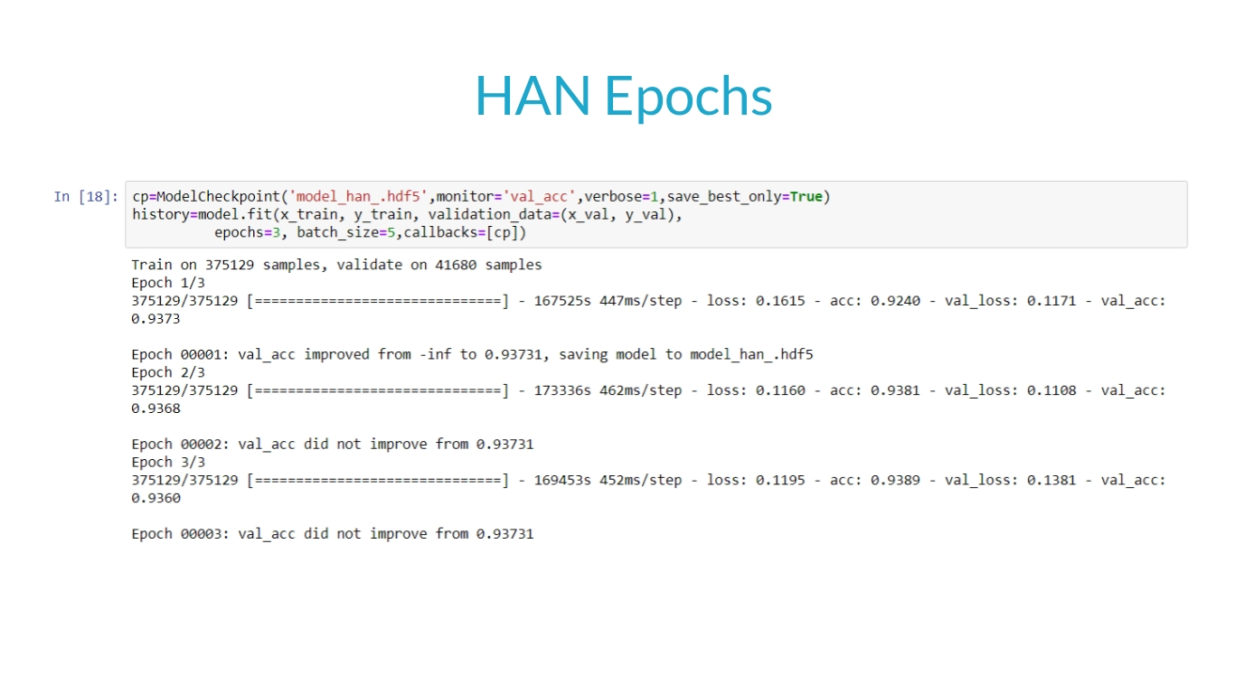

Slide 28
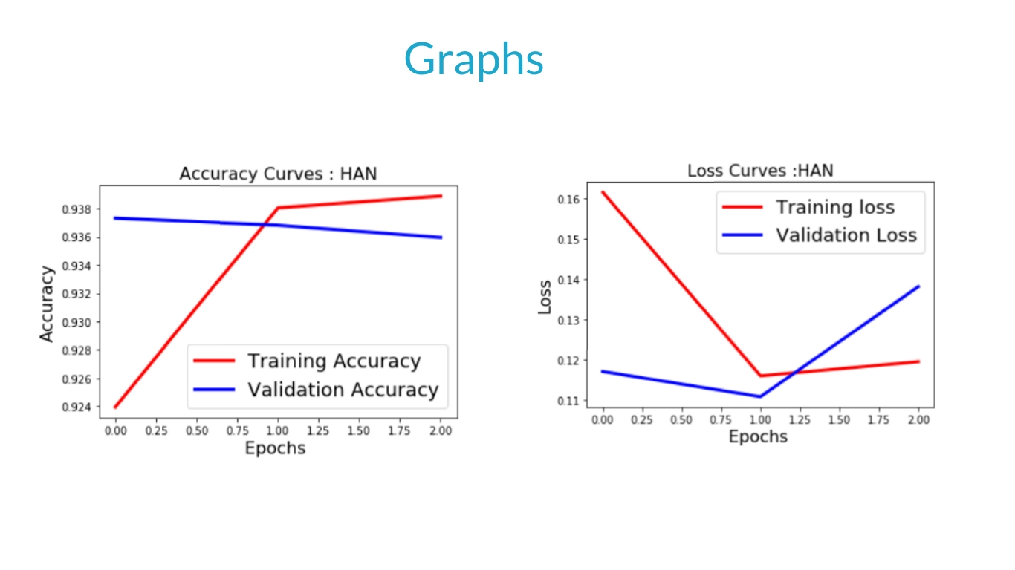

Slide 29
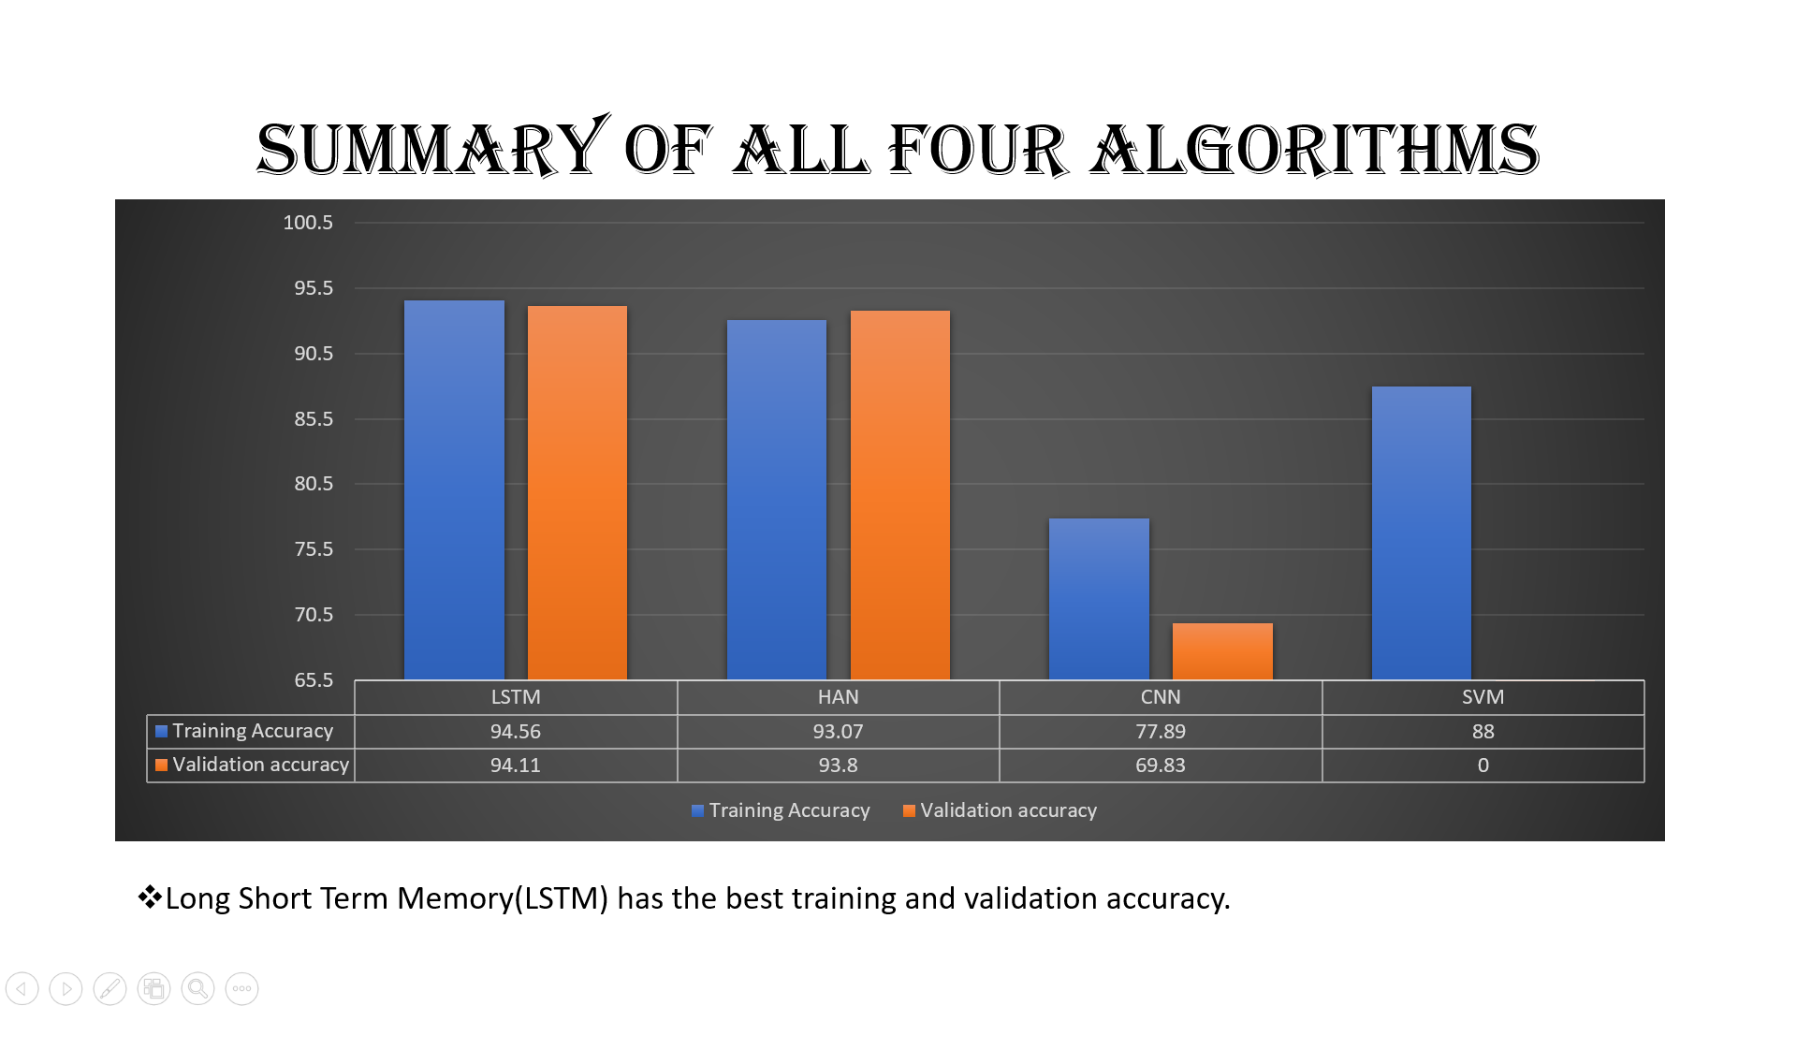

Slide 30
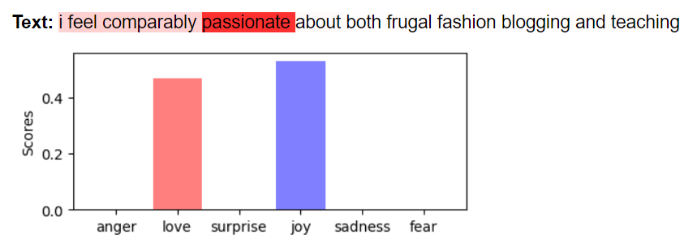
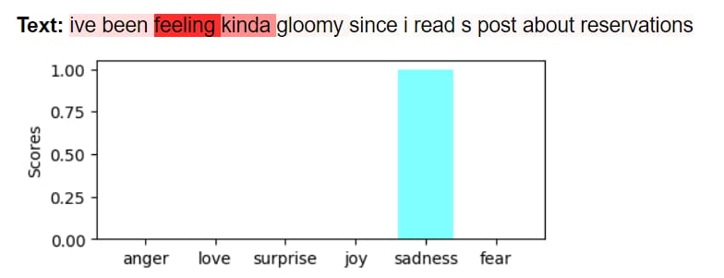
Output: Recognizing emotions using LSTM

Slide 31
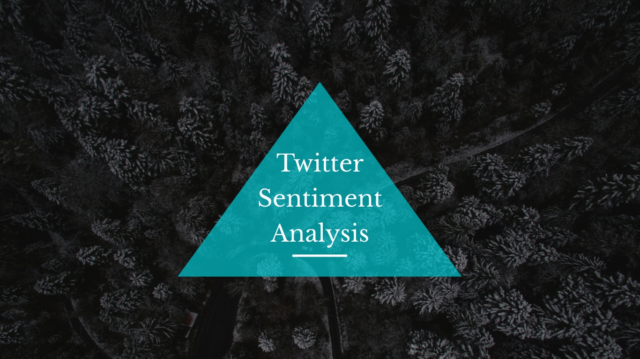

Slide 32
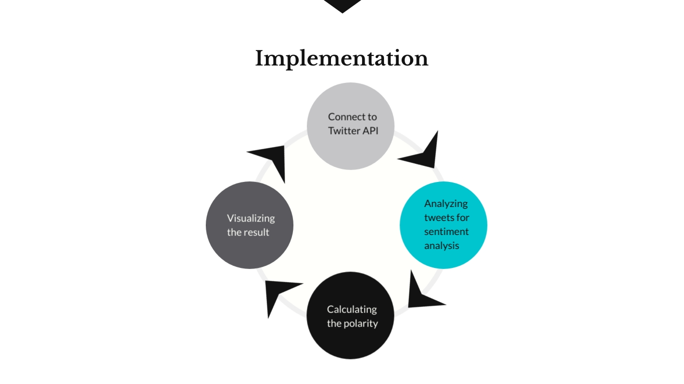

Slide 33


Slide 34
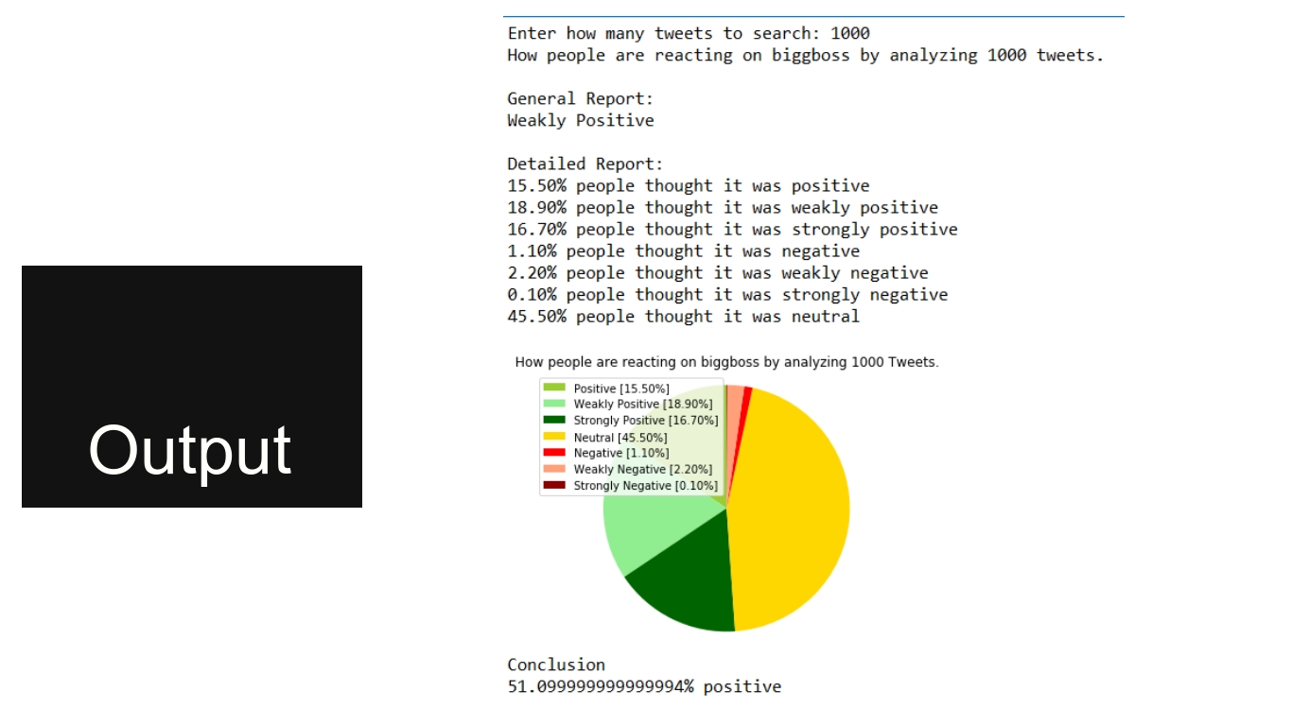

Slide 35
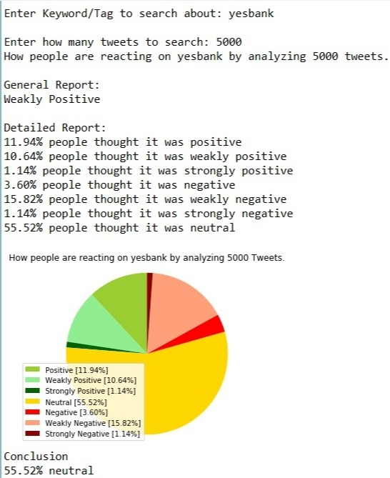
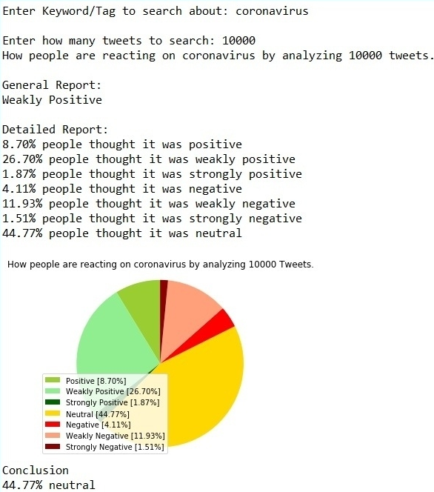
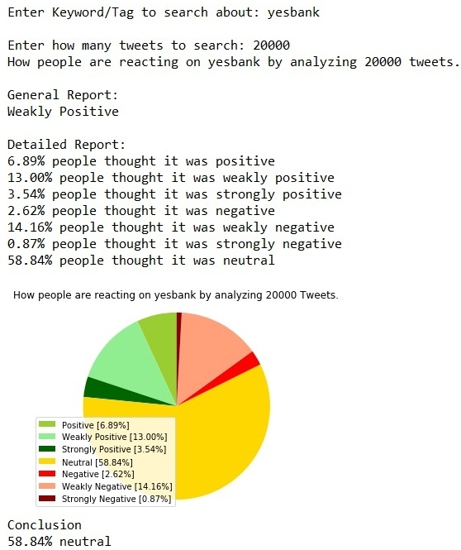
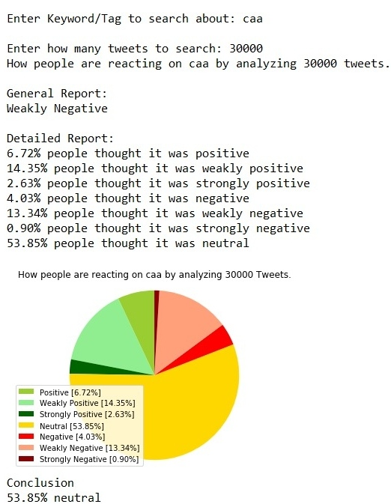
OUTPUT:

Slide 36
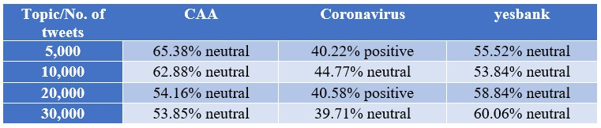
Summary of real-time data
We have compressed the emotions that were extracted from the twitter analysis and categorized it into positive negative and neutral. This summary depicts the polarity which was maximum in the particular topic.

Slide 37
Conclusion:
In our project, we have implemented emotion recognition from a dataset using CNN, LSTM, HAN and SVM algorithm.
We have analyzed output using all the algorithm and concluded that LSTM gives the best training and validation accuracy compared to other algorithms.
We have also calculated polarity from the real time twitter data and analyzed the output by varying 5000-30000 tweets on each keyword.

Slide 38
Future scope
In the future works, we will extend this emotion recognition encoding to other tasks such as affective computing and sentiment analysis.
It is also possible to improve the performance of this model by using the larger emotion word embeddings.
Also same emotion recognition model can be implemented for pictorial data as well as data in audio format.

Slide 39
Publication
V. Preethi, Nimisha Jadav, Komal Shirsat, Mohan Bonde, “Emotion Recognition from Text using LSTM algorithm,” International Journal of Computer Sciences and Engineering, Vol.8, Issue.6, pp.31-34, 2020.
Nimisha Jadav, Komal Shirsat, V Preethi, Mohan Bonde, "Emotion extraction from text: Analysis of four different algorithms", International Journal of Emerging Technologies and Innovative Research (www.jetir.org), ISSN:2349-5162, Vol.7, Issue 6, page no.2086-2092, June-2020

Slide 40


